Slide 1
class MatrixMul{
int[ ] [ ] mat1 = new int [ 3] [3];
int[ ] [ ] mat2 = new int [ 3] [3] ;
int[ ] [ ] result = new int [ 3] [3] ;
int rows1, cols1, rows2, cols2;
MatrixMul(int [ ] [ ] m1, int[ ][ ] m2, int r1, int c1, int r2, int c2) {
mat1=m1;
mat2=m2;
rows1=r1;
cols1=c1;
rows2=r2;
cols2=c2;
}
int checkMatrices() {
int solution = 1;
rows1=Integer.parseInt(JOptionPane.showInputDialog("Enter Rows1"));
rows2=Integer.parseInt(JOptionPane.showInputDialog("Enter Rows2"));
cols1=Integer.parseInt(JOptionPane.showInputDialog("Enter Cols1"));
cols2=Integer.parseInt(JOptionPane.showInputDialog("Enter Cols2"));
if(cols1!= rows2){
JOptionPane.showMessageDialog(null,"Matrix Multiplication not possible");
solution = 0;
}
return solution;
}
void MultiplyMatrix( ){
int c, d, k, i, j;
int sum=0;
for ( c = 0 ; c < rows1; c++ )
{
for ( d = 0 ; d < cols2 ; d++ )
{
for ( k = 0 ; k < rows2 ; k++ )
{
sum = sum + mat1[c][k]*mat2[k][d];
}
result[c][d] = sum;
sum = 0;
}
}
}

Slide 2
class useMatMul{
public static void main(String[ ] args) {
int[ ][ ] m1= {{0, -1, 2}, {4, 11, 2}};
int[ ] [ ] m2={{3, -1}, {1,2}, { 6,1}};
MatrixMul obj = new MatrixMul(m1, m2, 2, 3, 3, 2);
obj.checkMatrices();
obj.MultiplyMatrix();
}
}

Slide 3
Create an Employee class (private : empName, Id, wage). Provide an empty non-parameterize constructor & get & set methods. Now create a public class company which calls the method registerEmployee (no arguments). In registerEmployee create an array of objects of Employee class & initialize the instance variables using set methods. registerEmployee returns an array of object of Employee class which is passed to showRecords(Employee[ ]) method which uses the get methods to display fields of each employee.

Slide 4
class Employee{
private String strEmpName;
private int iId;
private double dWage;
Employee( ) {
strEmpName = "";
iId = 0;
dWage = 0.0; }
String getstrEmpName(){
return strEmpName;
}
int getId(){
return iId; }
double getWage(){
return dWage; }
void setEmpName(String str1){
strEmpName = str1; }
void setId(int id1) {
iId = id1;
}
void setWage(double wage1){
dWage = wage1;
}
}
public class QuizEmployee {//Company
static Employee[ ] registerEmployee(){
Employee[] objEmp = new Employee[10];
for(int i=0; i<objEmp.length;++i){
objEmp[i] = new Employee(); objEmp[i].setEmpName("Name"+ i);
objEmp[i].setId(i+100);
objEmp[i].setWage(1000.0 + i);
}
return objEmp;
}
static void showEmployee(Employee[] refEmp){
for(int i=0; i<refEmp.length;++i){
JOptionPane.showMessageDialog(null, " " + refEmp[i].getstrEmpName());
JOptionPane.showMessageDialog(null, " " + refEmp[i].getId());
JOptionPane.showMessageDialog(null, " " + refEmp[i].getWage());
} }

Slide 5
public static void main(String[] args) {
// TODO code application logic here
Employee[] objEmp = new Employee[10];
//for(int i=0;i<objEmp.length;++i)
// objEmp[i] = new Employee();
objEmp = registerEmployee();
showEmployee(objEmp);
}
}

Slide 6
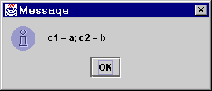
The char data type, More String, Buffered
If we want to represent individual characters, then we can use the char data type.
A char variable takes numerical values, which Java then interprets as characters. We can assign values using
numbers, or by placing the character we want to represent between single quotes:
char c1 = 'a';
char c2 = 98;
ud.showMessage("c1 = " + c1 + "; c2 = " + c2);

Slide 7
char arrays and Strings
We can create arrays of chars just like any other data type.
char list[] = {'h', 'e', 'l', 'l', 'o'};
In fact, the internal representation of a String is very like an array of characters.
Java provides three methods for getting more information on the characters that make up a String:
length(): returns the number of characters, as an int
charAt(i): returns the char at pos i (Strings start at pos 0)
getChars(i, j, x, k): get all the chars from position i up to j (not including j), and put them in array x, starting at pos k

Slide 8
Examples
how many characters are in the string?
String output;
String s1 = "Hello world!";
char array[] = new char[5];
int len = s1.length();
char fifth = s1.charAt(4);
s1.getChars(3,8,array,0);
output = "length = " + len +
"; 5th char = " + fifth +
"\narray = ";
for (int i=0; i<5; i++)
output += array[i];
output += "\n";
What char is at pos 4?
(Strings start at pos 0)
What chars are between pos 3 and pos 8 (not including 8)? Put in array, starting at array[0].

Slide 9
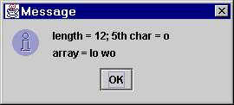
running the program
5th char (pos 4)
Hello world!
chars in pos 3,4,5,6,7
Note: the space is a character,
so the length is 12.

Slide 10
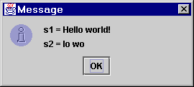
Initialising Strings from char arrays
We can use a char array to give initial values to a String.
For example, we can use getChars(...) to extract as an array a range of characters from one String, and then use the array to put those characters in a new String:
String s1 = "Hello world!";
char array[] = new char[5];
s1.getChars(3,8,array,0);
String s2 = new String(array);
ud.showMessage("s1 = " + s1 +
"\ns2 = " + s2);
initialising a new
String with an array

Slide 11
Comparing Strings
String provides a number of methods apart from equals(...) to compare strings:
are s1 and s2 equal, ignoring case?
s1.equalsIgnoreCase(s2)
s1.compareTo(s2)
s1.regionMatches(i,s2,j,n).
s1.regionMatches(bool, i, s2, j, n)
returns < 0 if s1 before s2, 0 if equal, > 0 if after
returns true if s1 from pos i is the same as s2 from pos j for n positions
as above, but if bool is true, ignores case

Slide 12
comparing Strings (2)
Does s1 start with all the characters of s2?
s1.startsWith(s2)
s1.endsWith(s2)
s1.indexOf(s2)
Does s1 end with all the characters of s2?
If s2 is a substring of s1,
return the starting pos of s2 inside s1; else
return -1
Note: "cat", "at", "tch", "" and "catch" are substrings of
"catch"

Slide 13
Testing the methods
String s1 = "apple";
String s2 = "Banana";
String s3 = "Cat";
String s4 = "APpLE";
String s5 = "pineapple";
String s6 = "scatter";
String s7 = "catch";
String output = s1 + " and " + s4 + " are the same: ";
output = output +s1.equalsIgnoreCase(s4) + "\n";
output = output + "comparing " + s2 + " & " + s3;
output = output + " gives: " + s2.compareTo(s3) + "\n";
output = output + "pl is in " + s1 + " & " + s5 + ": ";
output = output + s1.regionMatches(2, s5, 6, 2) + "\n";

Slide 14
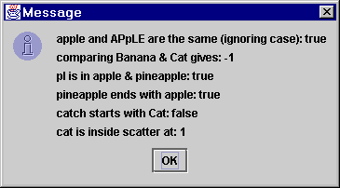
Testing the methods (2)
output = output + s5 + " ends with " + s1 + ": ";
output = output + s5.endsWith(s1) + "\n";
output = output + s7 + " starts with " + s3 + ": ";
output = output + s7.startsWith(s3) + "\n";
output = output + "cat is inside " + s6 + " at: ";
output = output + s6.indexOf("cat");
ud.showMessage(output);

Slide 15
Extracting substrings
If we know the start and end points of the substring we want,
there is a method that will extract it as a new String:
s1.substring(5, 10)
will extract the substring from pos 5 to 10, not including 10.
s1.substring(5)
will extract the substring starting at pos 5 until the end.

Slide 16
Converting Strings
s1.toUpperCase()
will convert s1 to upper case (capital letters) and return it as a new string.
s1.toLowerCase()
will convert s1 to lower case (small letters) and return it as a new string.
s1.concat(s2)
will add s2 onto the end of s1, and return it as a new string.
None of these methods will change s1.

Slide 17
Example
How would we check to see whether a user has typed the word "yes" into a dialog box, in any form?
Convert the response into upper case
Ask for the index of "YES" as a substring.
String input = ud.getString("Type yes :");
String s1 = input.toUpperCase();
if (s1.indexOf("YES") > -1)
ud.showMessage("typed \"yes\"");

Slide 18
The method indexOf() is used for finding out the index of the
specified character or substring in a particular String.
There are 4 variations of this method:
int indexOf(int ch):
It returns the index of the first occurrence of character
ch in a String.
int indexOf(int ch, int fromIndex):
It returns the index of first occurrence if character ch,
starting from the specified index “fromIndex”.
int indexOf(String str): Returns the index of string str in a
particular String.
int indexOf(String str, int fromIndex):
Returns the index of string str, starting from the specified
index “fromIndex”.

Slide 19
The Character class
The Character class provides methods allowing us to check the properties of char variables:
isDigit(c)
isLetter(c)
isLetterOrDigit(c)
isUpperCase(c)
isLowerCase(c)
toUpperCase(c)
toLowerCase(c)
return true or false
return a char variable

Slide 20
Example
How would we check whether a user has input a digit?
String s1 = ud.getString("input:");
char c = s1.charAt(0);
if (Character.isDigit(c))
ud.showMessage("Entered a digit: " + c);
or entered a y or Y (to say Yes)?
...
c = Character.toUpperCase(c);
if (c == 'Y')
ud.showMessage("Entered yes");

Slide 21
A program is required to process student exam results. Each Student sits in 3 exams. The first exam is weighted as 50% of the marks for the year, the second and third exams each count for 25% of the marks. The program should report the overall mark awarded to each student, highest, lowest and average class marks.
What is a SENTINEL in programming?

Slide 22
https://www.webopedia.com/TERM/S/sentinel_value.html
In computer programming, a sentinel value (also referred to as a flag value, trip value, rogue value, signal value, or dummy data) is a special value in the context of an algorithm which uses its presence as a condition of termination, typically in a loop or recursive algorithm.

Slide 23
public class MarksProg {
double dTM, dHM, dLM, dAM;
double dOAM;
double dAvgMarks;
final int iMarkSentinel = -999;
int iEM1, iEM2, iEM3;
MarksProgKIIT(){
dTM=0.0;
dHM=-1.0;
dLM=101.0;
}
void calculateOAM(){dOAM = iEM1 * 0.5 + iEM2 *.25 + iEM3 *.25;}
void updateTotal(){
dTM = dTM + dOAM;
if(dOAM > dHM)
dHM = dOAM;
if(dOAM < dLM)
dLM = dOAM;
}
void calculateAverage(int iStudentCnt){
dAM = dTM / iStudentCnt;
}
void displayTotals(){ JOptionPane.showMessageDialog(null, "current OAM = "+ dOAM+ " Total = " +dTM+ " Highest Mark = dHM " +dHM+ " Lowest Mark = "+ dLM); }
public int igetExamMark1(){
iEM1 = Integer.parseInt(JOptionPane.showInputDialog("Input Exam1 Mark out of 50"));
return iEM1; }
public int igetExamMark2(){
iEM2 = Integer.parseInt(JOptionPane.showInputDialog("Input Exam2 Mark out of 25"));
return iEM2; }

Slide 24
public int igetExamMark3(){
iEM3 = Integer.parseInt(JOptionPane.showInputDialog("Input Exam3 Mark out of 25"));
return iEM3;
}
Read Ahead Technique??
public static void main(String[] args) {
// TODO code application logic here
int iStudentCnt;
int iexamMark1=0;
MarksProg objSER = new MarksProg();
iexamMark1 = objSER.igetExamMark1();
while (iexamMark1 != -999) {
objSER.igetExamMark2();
objSER.igetExamMark3();
objSER.calculateOAM();
objSER.updateTotal();
objSER.displayTotals();
iexamMark1 = objSER.igetExamMark1();
}
JOptionPane.showMessageDialog(null,"Outside loop");
}
}

Slide 25
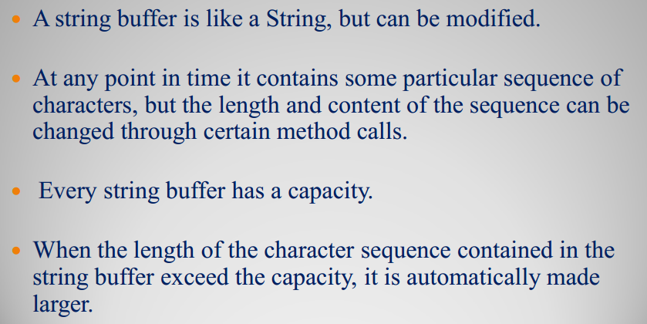
StringBuffer

Slide 26
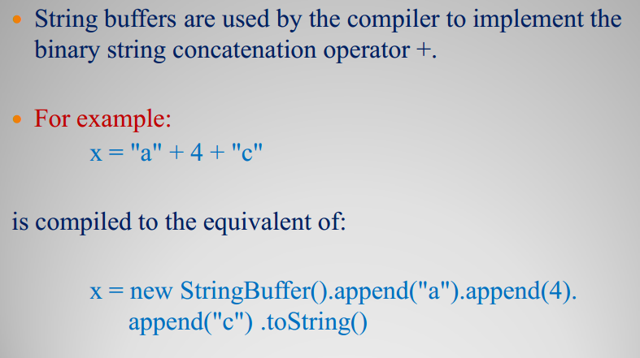

Slide 27
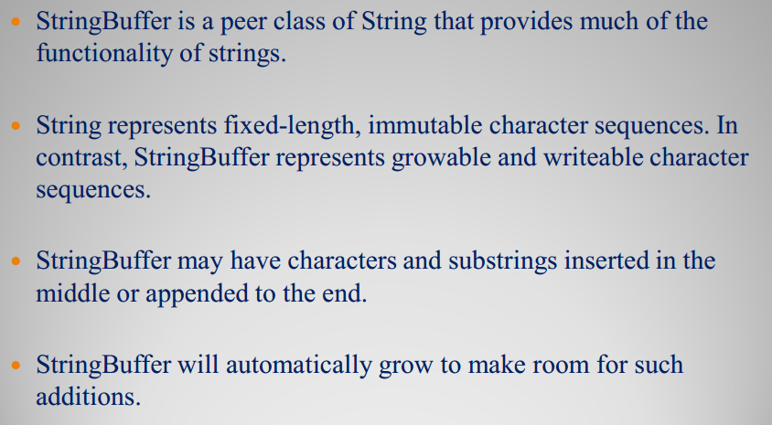

Slide 28
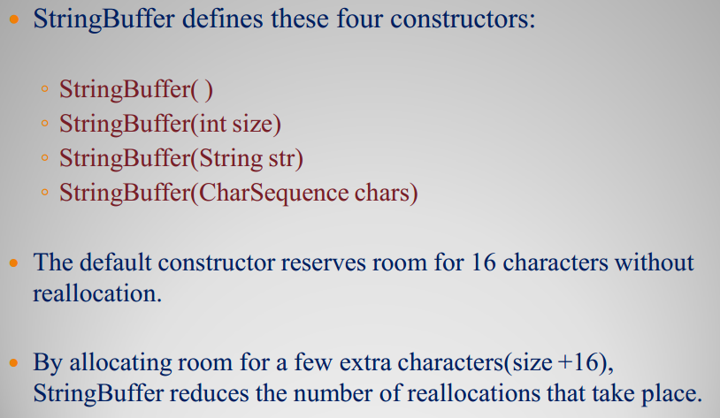

Slide 29
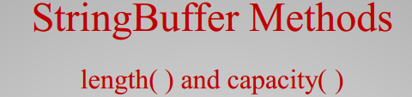
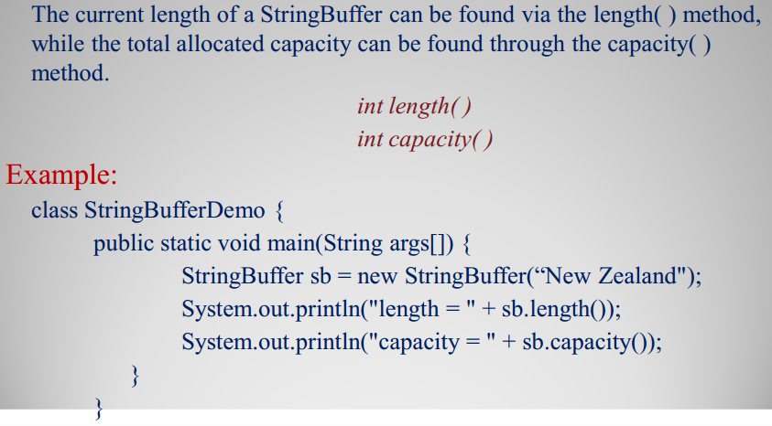

Slide 30

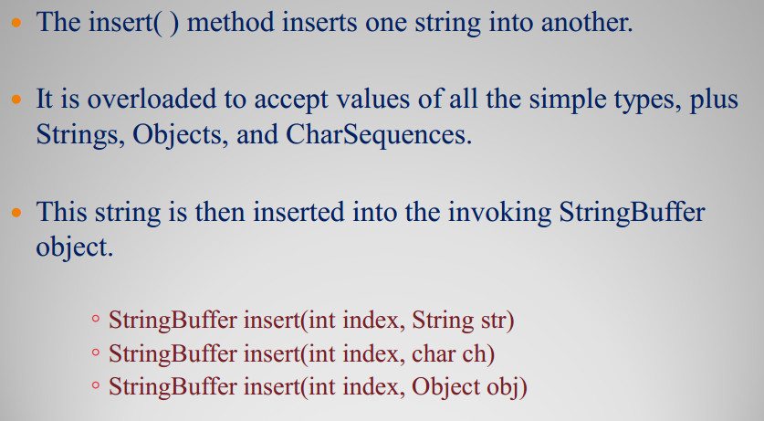

Slide 31
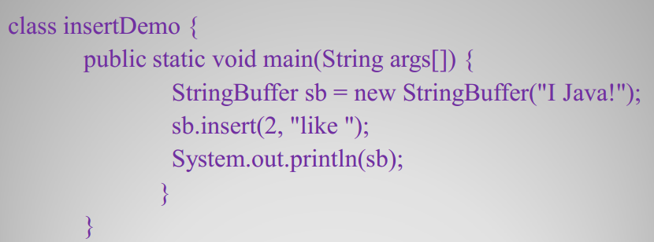

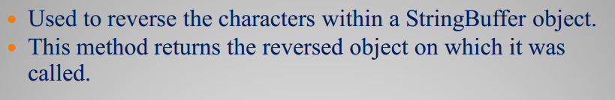

Slide 32
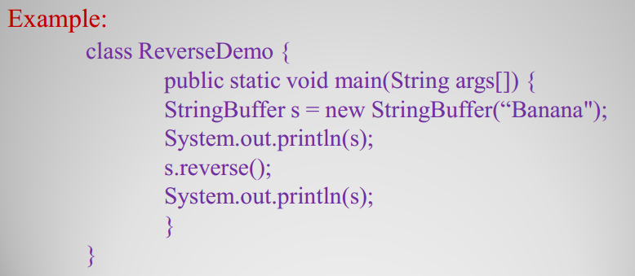

Slide 33
Why are the Strings immutable?
https://stackoverflow.com/questions/
22397861/why-is-string-immutable-in-java
This is because no method of String class
Can change an existing string.
Why we say that Strings are incomparable?
For comparison, we use mathematical
operators like ==, > or < but this is not
Possible in case of String.

